Slide 1
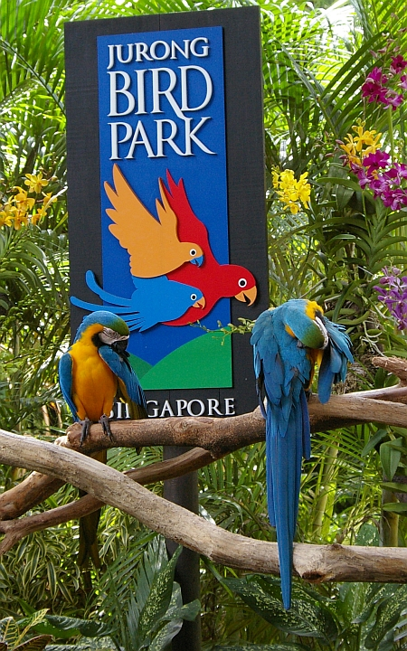
Jurong Bird Park
4_Erin Palmon_Class

Slide 2
Enjoy Youself in Five Attractions
Lory Loft
Flamingo Lake
Penguin Coast
Birds of Prey
World of Darkness

Slide 3
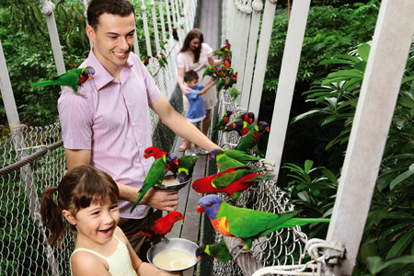
Lory Loft
Say g'day to some of the friendliest birds at the Park! In the world's largest Lory flight aviary, you'll see bright colours of red, yellow, green and blue fluttering above your heads, and around you. And if you're lucky, you might even have some of them perch on you while you stroll around the Australian outback-themed 3,000 square-metre aviary!

Slide 4
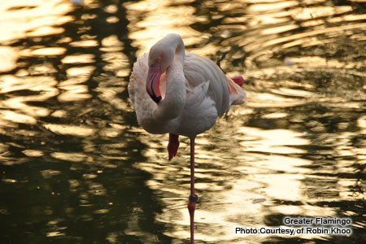
Flamingo Lake
Step into one of the most photographed places at the Park, especially for wedding photo shoots. Be charmed by the tranquility of Flamingo Lake, where hundreds of pink-hued Greater Flamingos and Lesser Flamingos live. Watch them from afar as they strut in style or wade through the water in search for food.

Slide 5
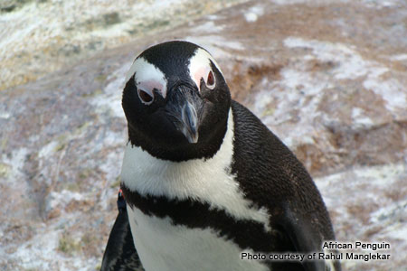
Penguin Coast
Ahoy mates, and step aboard the ship vessel where you'll embark on an exploration to see our tuxedoed friends, the penguins!

Slide 6
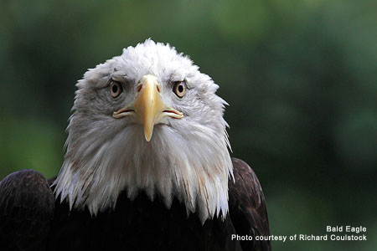
Birds of Prey
Hawks, eagles and vultures live side by side in towering enclosures on this magnificent street of kings – kings of the skies, that is. As you walk through this exhibit, look out for the sharp talons and hooked beaks and read up on the amazing stories behind each of these beautiful birds of prey.

Slide 7
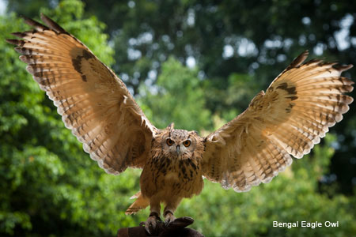
World of Darkness
Enter the darkness of night, in broad daylight at the World of Darkness, Asia's first nocturnal house. Walk through the star-lit jungle and meet our elusive friends, the owl as they go about their normal behaviours under the moonlit 'night'.

Slide 8
Click HERE to go to the Official Website

